Slide 1

WINE QUALITY
Classification Task of Wine Quality Based on Four Machine Learning Methods
Group 1
Haoxuan Liu, Zikang Liu, Hongyuan Jia

Slide 2
行业PPT模板http://www.1ppt.com/hangye/
CONTENTS
PART 01
PART 02
PART 03
PART 04
Dataset
Models
Comparison
Conclusion

Slide 3

01
PART ONE
Dataset
the quality of white wine

Slide 4
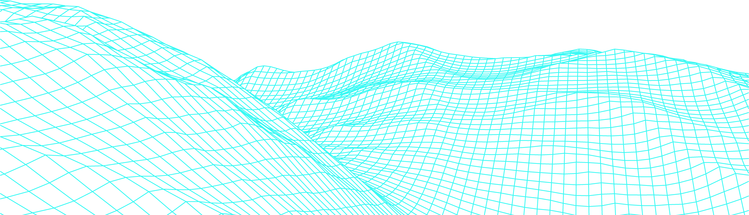
Objective
Aim to leverage machine learning techniques to predict wine quality
Understand the significance of physicochemical properties in determining wine quality.
Highlight the importance of data-driven decision-making in the wine industry.

Slide 5


Dataset Description
Total Attributes: 12
Dataset Source: UCI Machine Learning Repository - Wine Quality Dataset
The dataset related to white "Vinho Verde" wine samples from the north of Portugal.
The dataset models wine quality based on physicochemical tests.
Total Instances: 4898
Test Data: 20% of total
Train Data: 80% of total

Slide 6
Sample Records
Quality
Our dataset analyzes the quality of wines by a very large number of attributes, giving wine quality scores from 0 to 10.
There are a total of 12 attributes, the following are a few examples.
Volatile acidity
Fixed acidity
Chlorides
Residual sugar

Slide 7
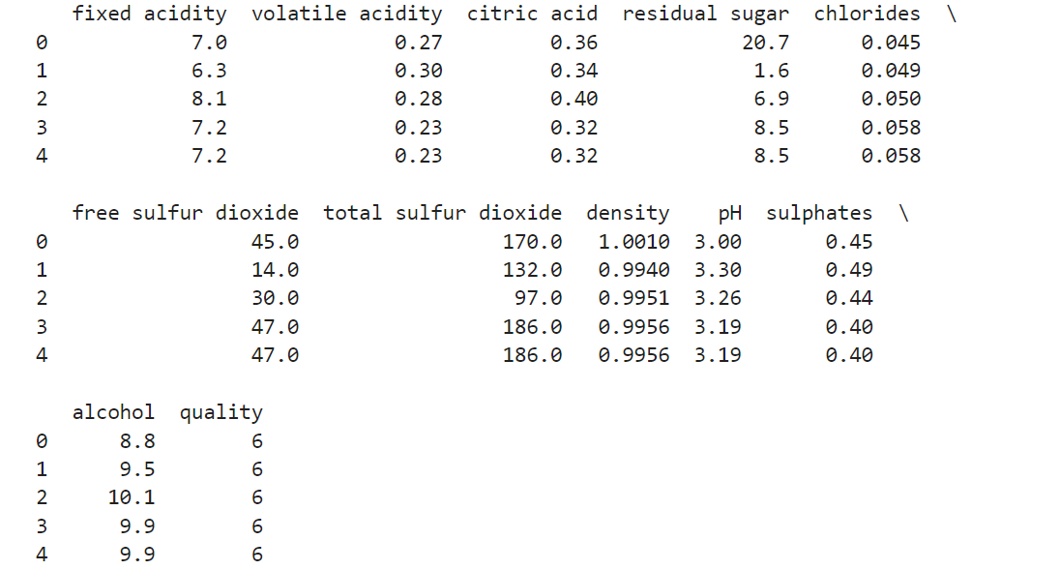
Display of the first five rows of data

Slide 8
02
Models
four methods of machine learning

Slide 9
Machine Learning Models
Naïve Bays
Neural Network
Model Description:
SVM
Naïve Bayes: A probabilistic classifier, ideal for datasets with multiple classes.
Support Vector Machines (SVM): Effective in high-dimensional spaces and best suited for binary classification.
Random Forest: An ensemble method that aggregates multiple decision trees for improved accuracy.
Neural Nwetwork：It has good robustness and fault tolerance; Using parallel distributed processing; Self-learning ability
Random Forest

Slide 10
Evaluation
Accuracy
(TP+TN)/(TP+FP+FN+TN)
Evaluation Indicators :
Using Accuracy, Precision, and Recall as the measure of performance. All these rates will be based on Confusion Matrix.
Confusion
Matrix
Precision
TP/(TP+FP)
Recall
TP/(TP+FN)

Slide 11
PART three
SVM Model
Using an SVM Model to Analyze Wine Quality Data

Slide 12
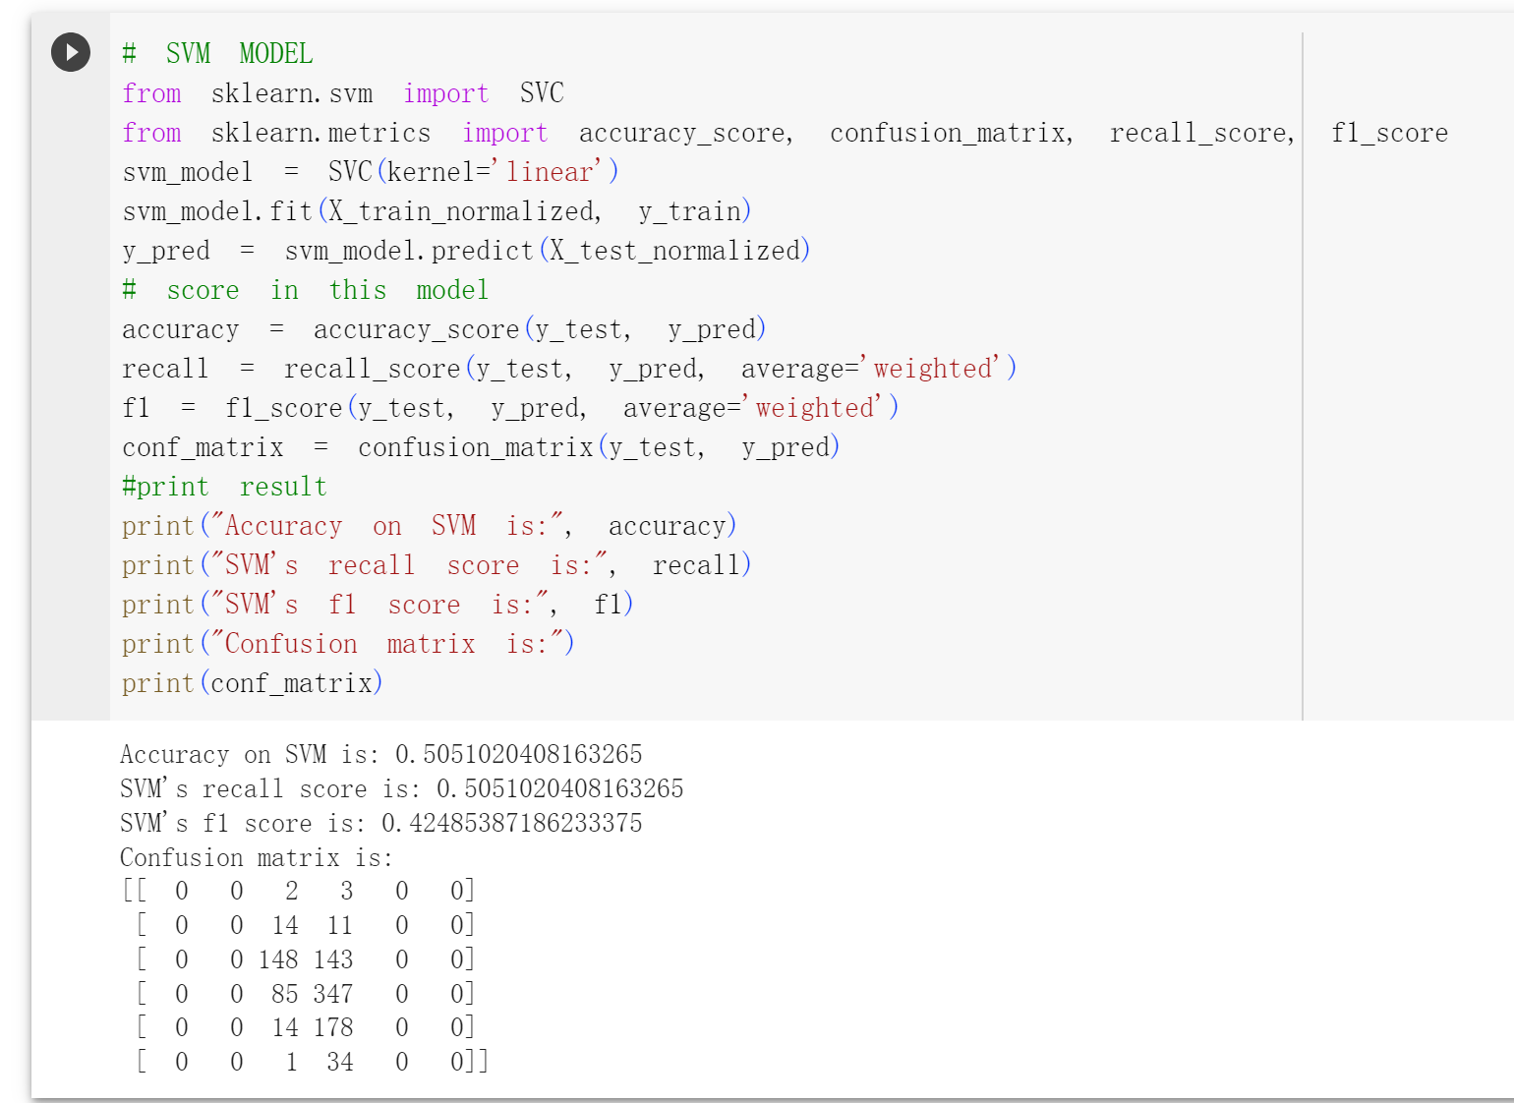
SVM
In this experiment, an SVM model is preset, in which the kernel function is linear.
In this experiment, the accuracy is 0.505, the recall is 0.505, and the F1 score is 0.424.
However, on this model, the accuracy and other results are not satisfactory.

Slide 13
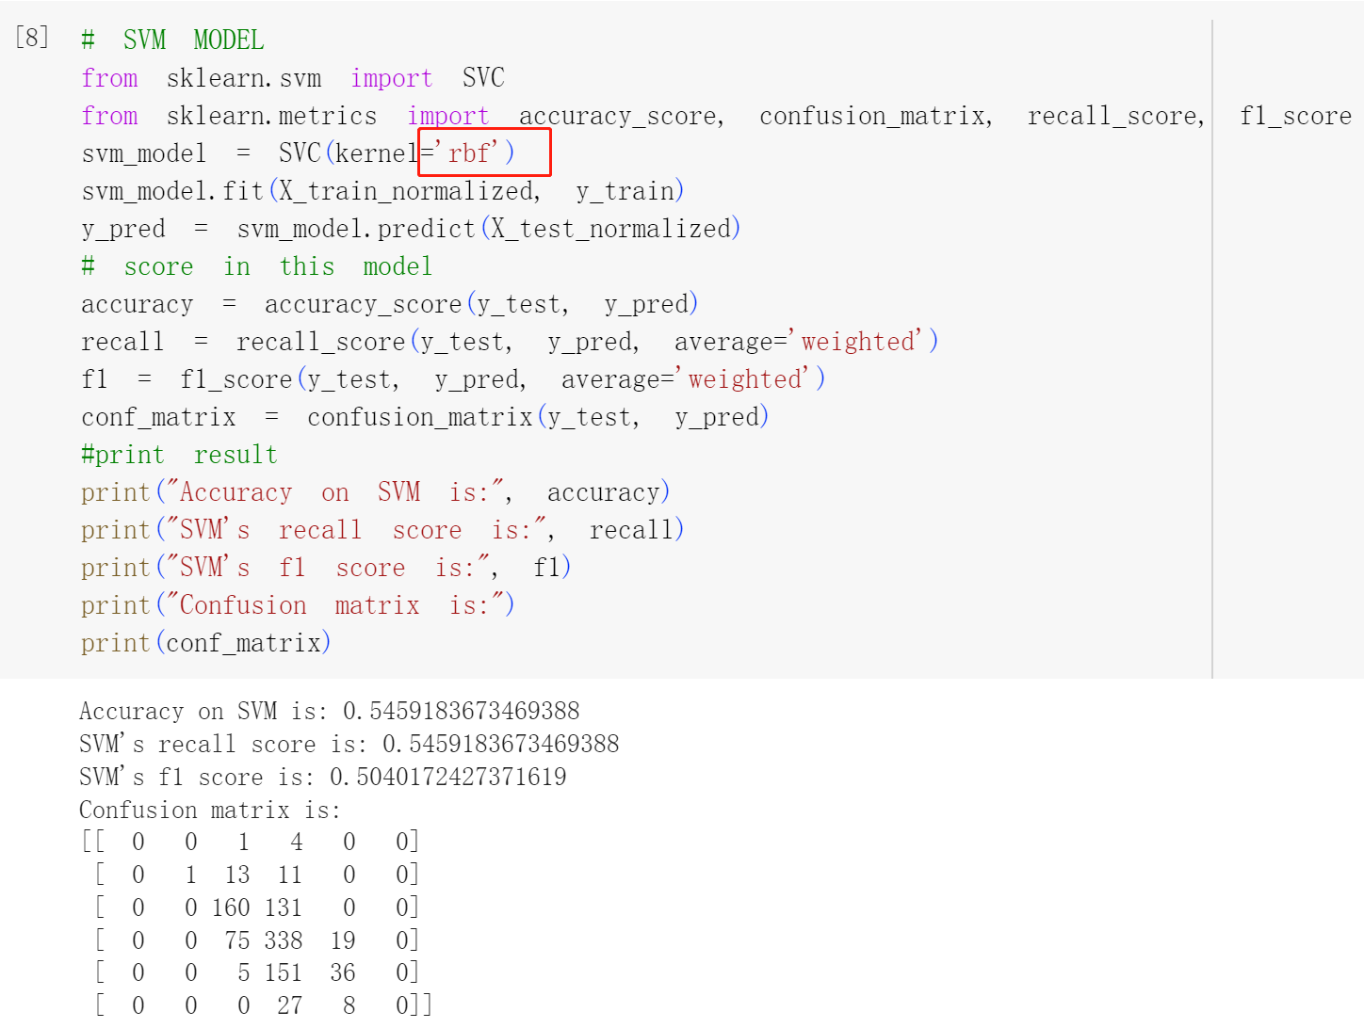
SVM
In order to pursue higher accuracy, this experiment replaced the kernel function with rbf.
In this experiment, the accuracy is 0.545, the recall is 0.545, and the F1 score is 0.504.
The results show that the change of the kernel function effectively improves the classification accuracy.

Slide 14
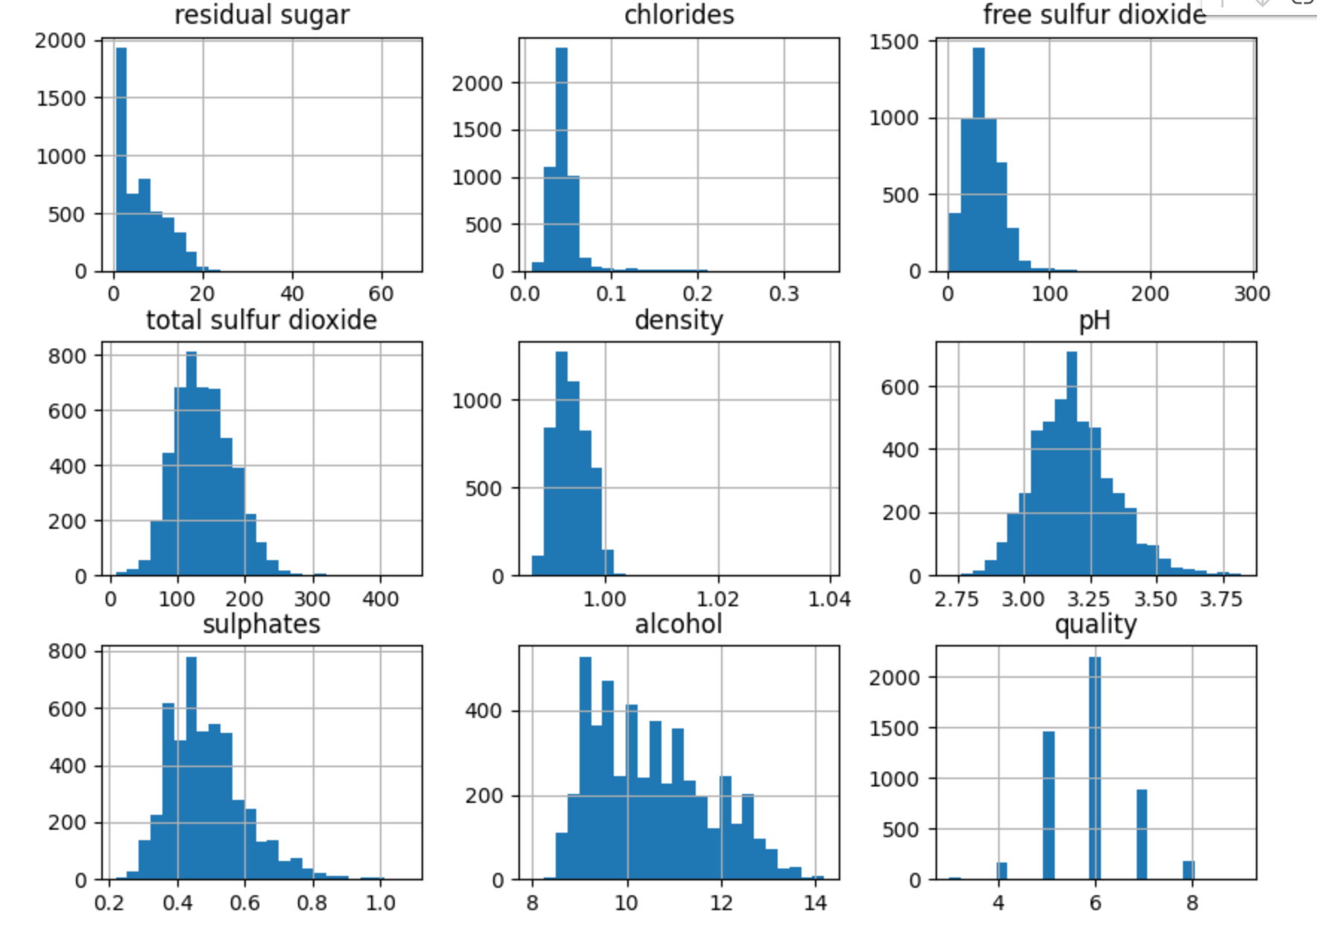
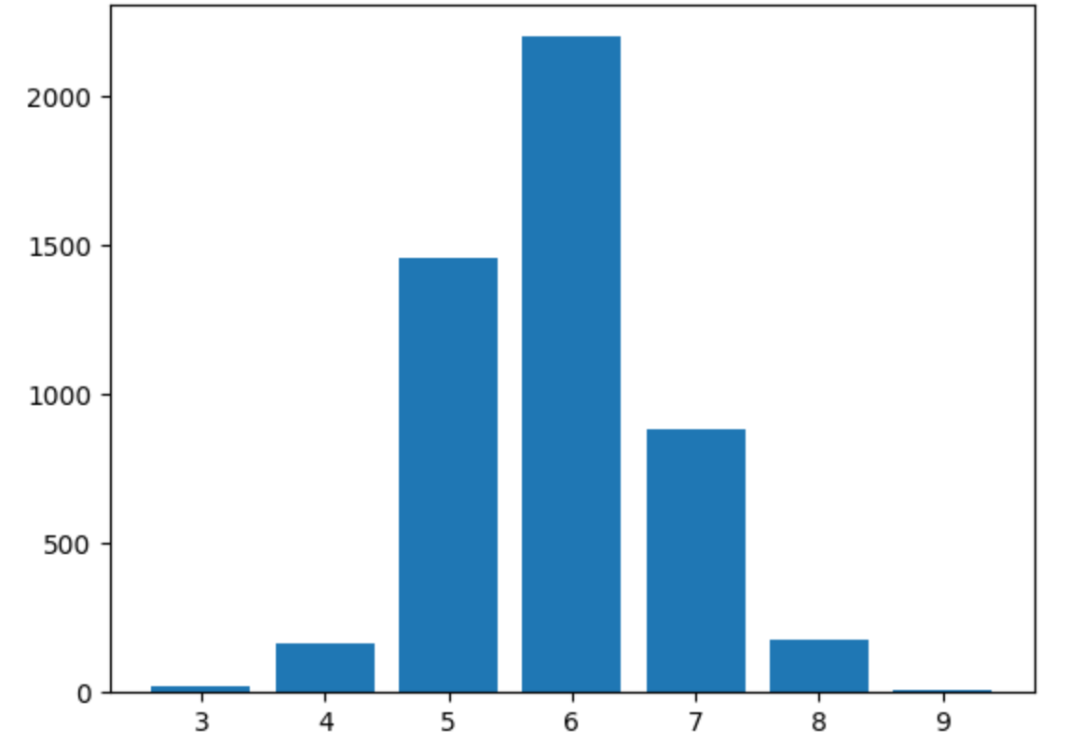
SVM
Due to the less-than-ideal results, the aim of the study is to identify the factors affecting the model's performance.

Slide 15
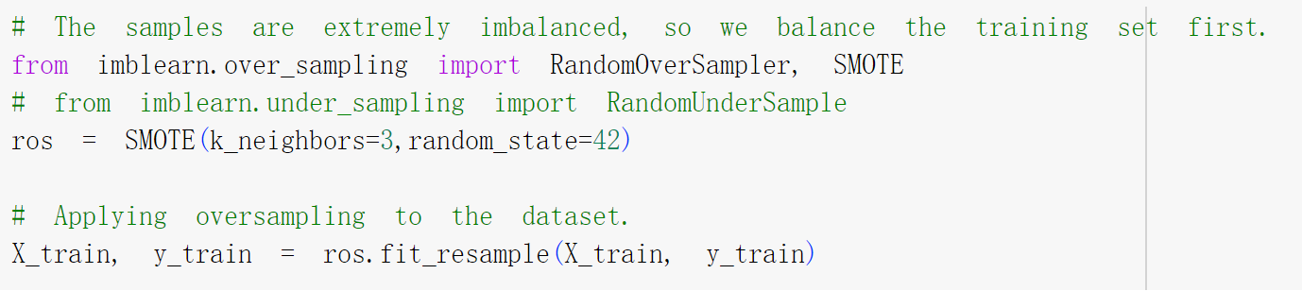
SVM
The samples are imbalanced.
Oversampling the training set is employed to address the issue of extremely imbalanced sample distribution.

Slide 16
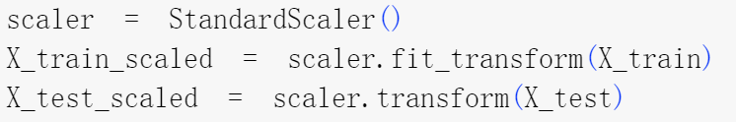
SVM
Applying standardization method to preprocess the data.

Slide 17
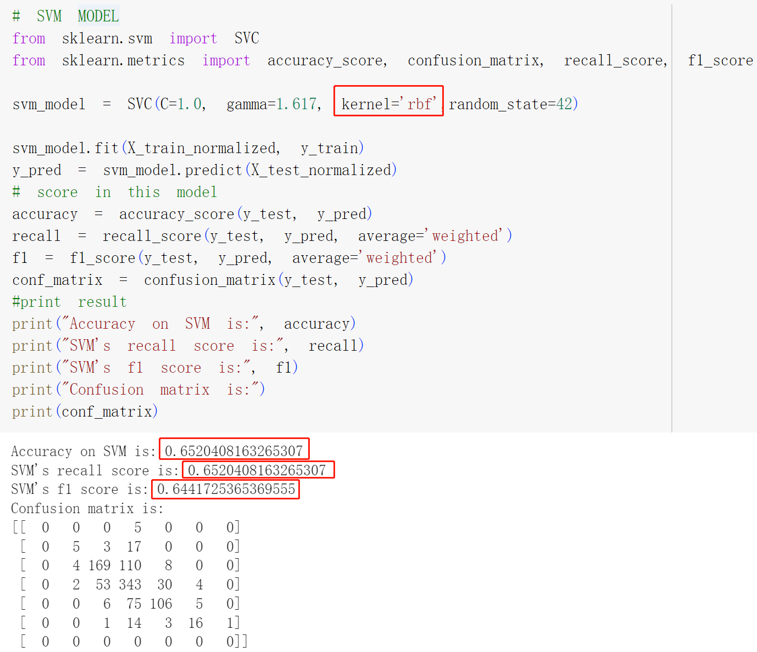
SVM

Slide 18
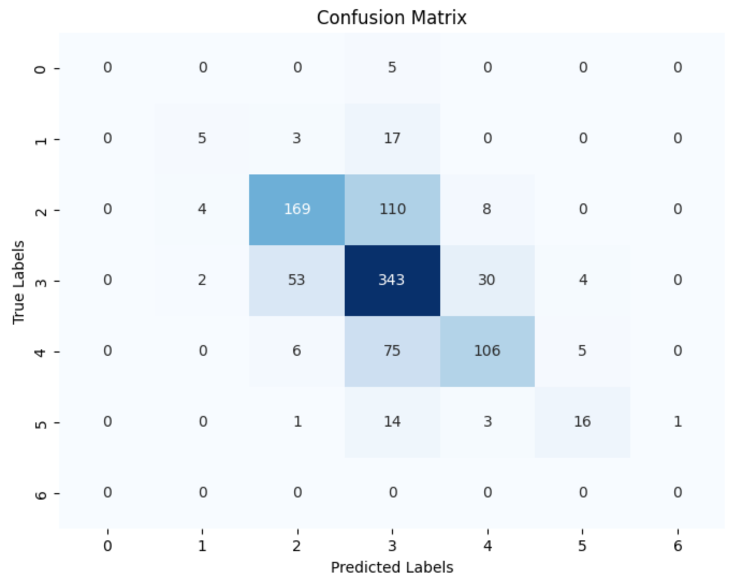
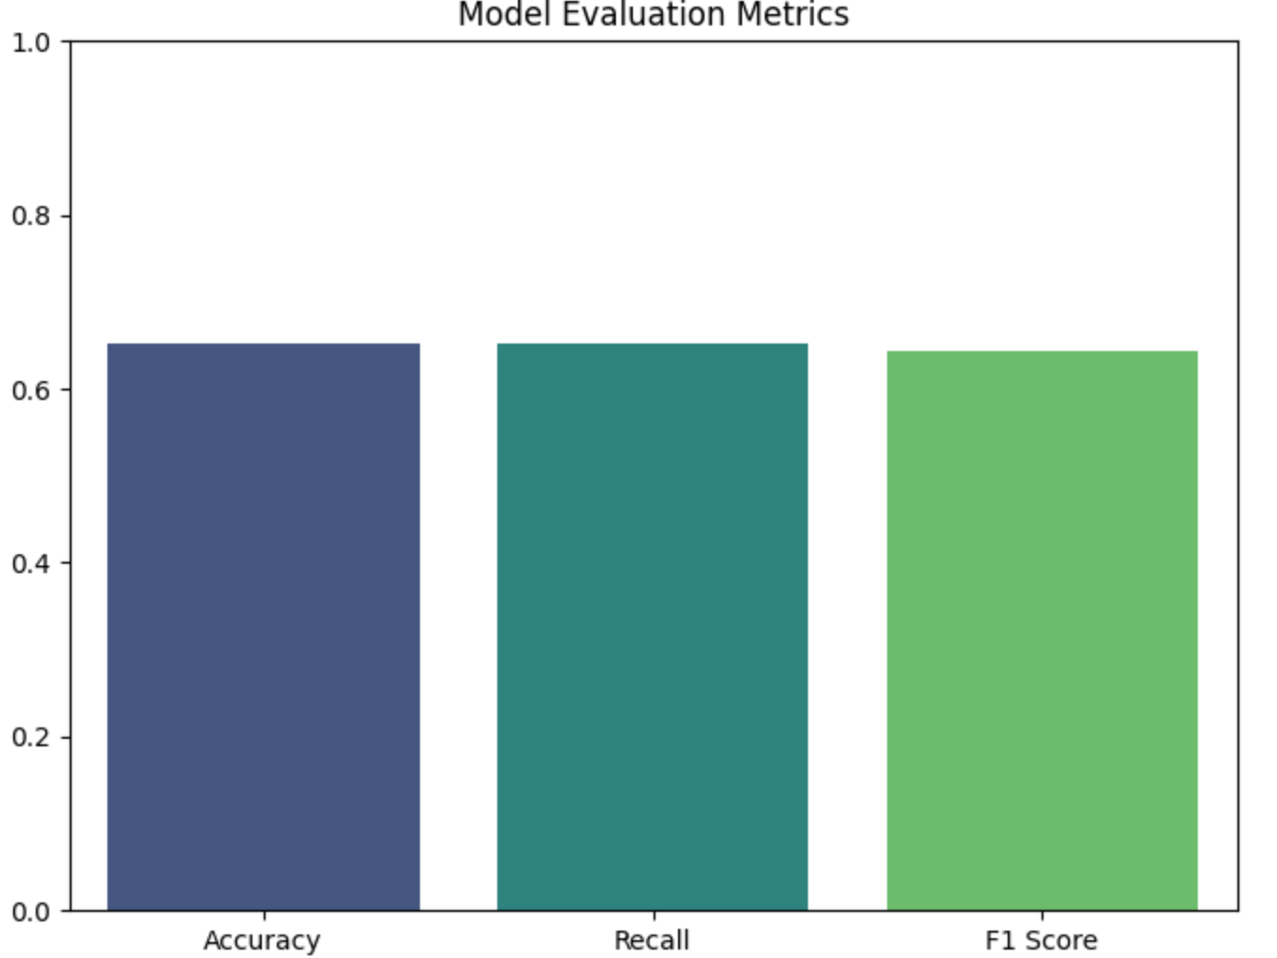
SVM

Slide 19
SVM MODEL
3.0
2.0
accuarcy:0.652
recall:0.652
f1 score：0.644
1.0
accuarcy:0.545
recall:0.545
f1 score：0.504
accuarcy:0.505
recall:0.505
f1 score：0.424
After adjusting the model's parameters, changing the kernel function, and experimenting with various data preprocessing techniques, there has been a significant improvement in the accuracy of the model.

Slide 20
PART three
Naive Bayes
Using Naive Bayes to Analyze Wine Quality Data

Slide 21
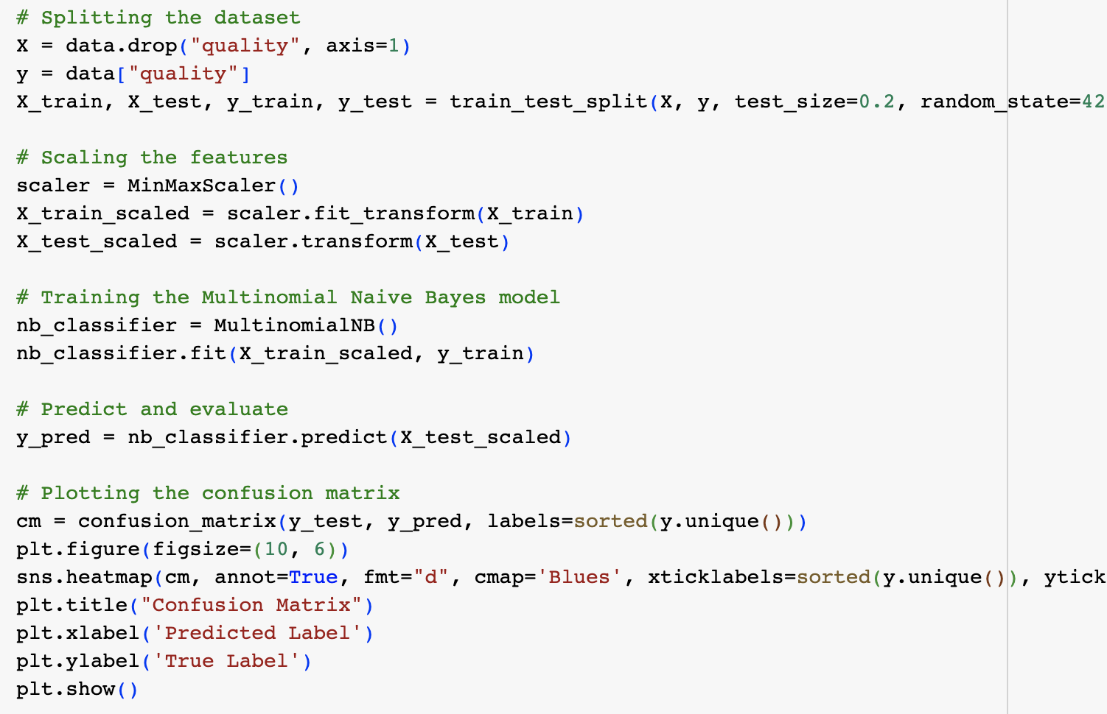
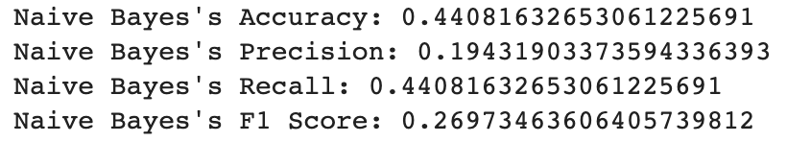
Naive Bayes
In this experiment, the accuracy is 0.44, the precision is 0.19, the recall score is 0.44, the f1 score is 0.26
Given that this was our baseline, it was an acceptable start.We are not satisfied with this data, and we will further optimize it later.

Slide 22
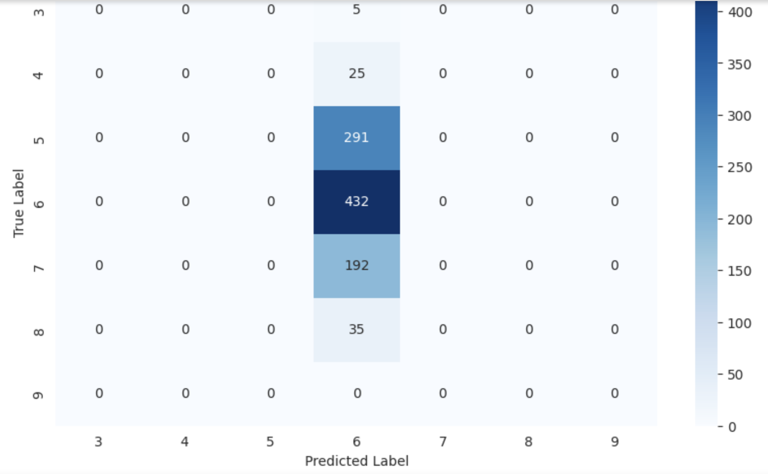
Naive Bayes - Confusion Matrix

Slide 23
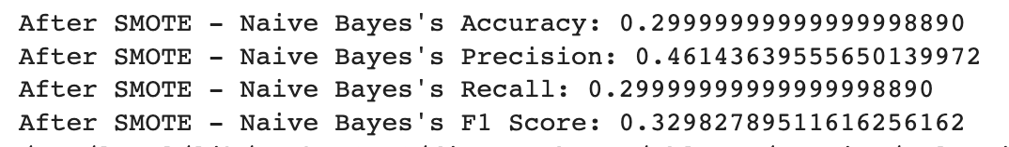
Naive Bayes
We have tried many things, and here are some of them.
SMOTE
Method: We tried oversampling the minority classes to handle class imbalance.
Outcome: The accuracy dropped to about 30%. This indicates that while the class distribution became more balanced, the artificially generated samples might not represent the true underlying distribution.

Slide 24
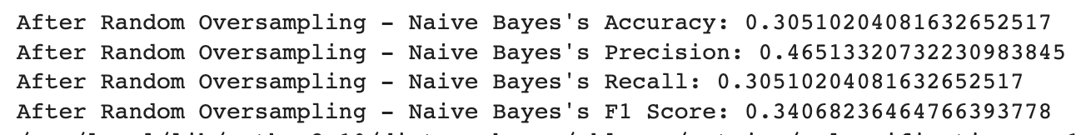
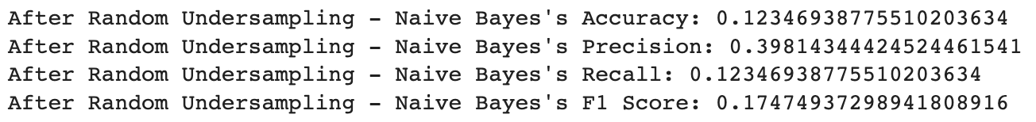
Naive Bayes
Random Oversampling
The accuracy was around 30.5%, which was slightly better than SMOTE but still not great.
Random Undersampling
The accuracy is around 12%, that's a very bad result

Slide 25
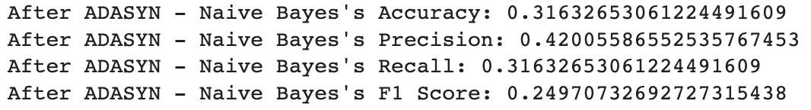
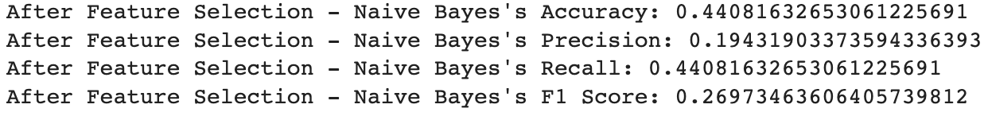
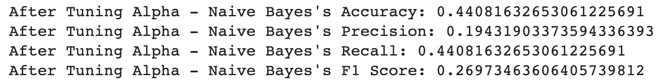
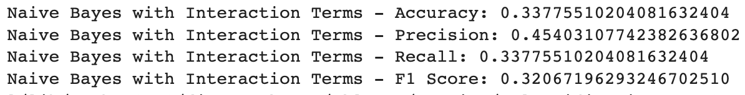
Naive Bayes
ADASYN (Adaptive Synthetic Sampling):
Feature Selection
Adjusted the alpha parameter of the Naive Bayes model. But no significant change in performance.
Interaction Terms

Slide 26
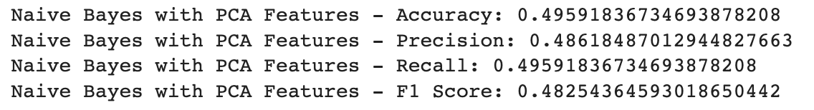
Naive Bayes
In comparison, it seems that use PCA for optimization is the best choice.
Method: Used Principal Component Analysis to reduce the dimensionality of the dataset.
Outcome: The accuracy improved notably to about 49.6%.

Slide 27
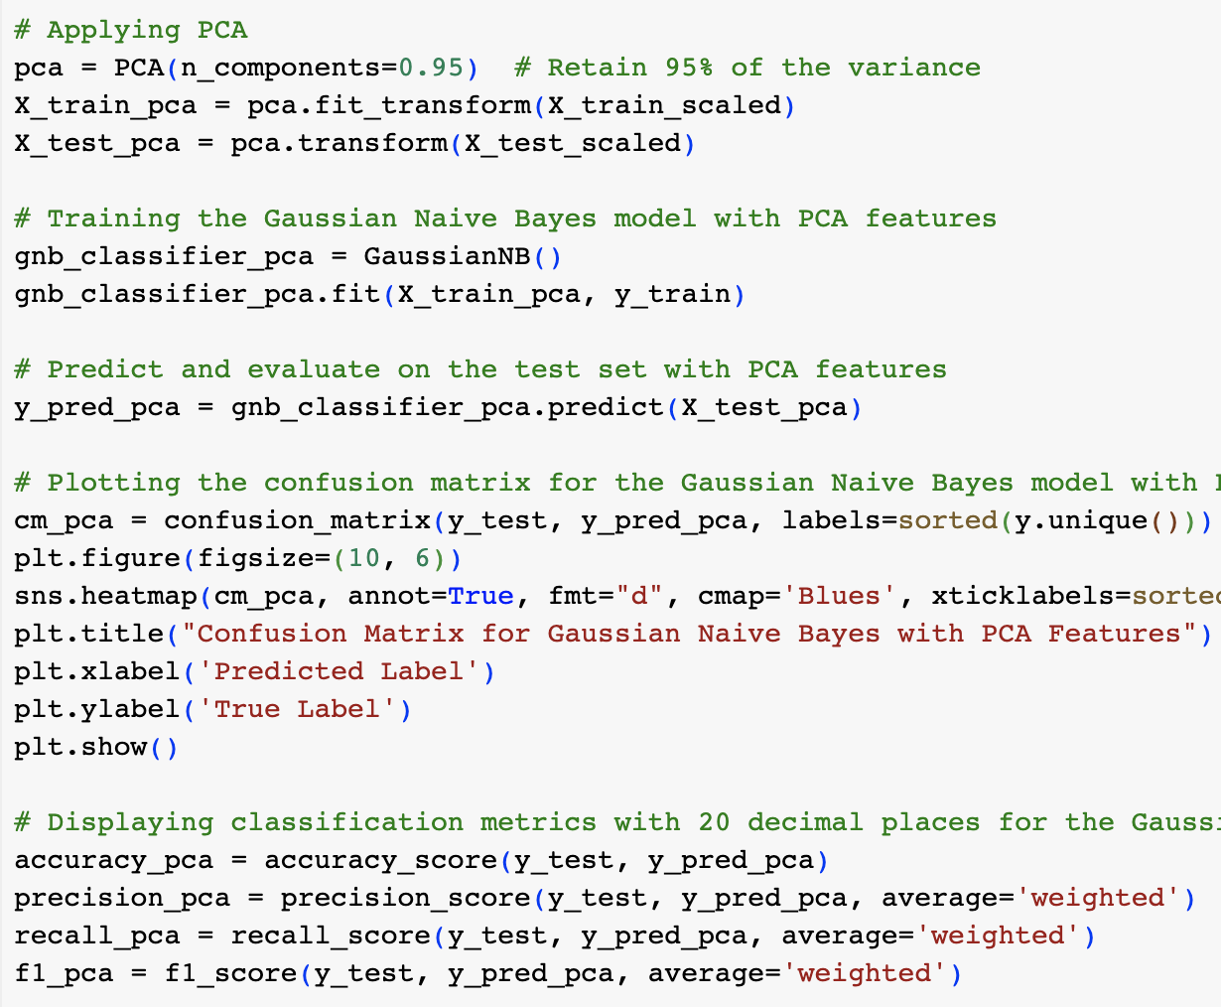
Naive Bayes

Slide 28
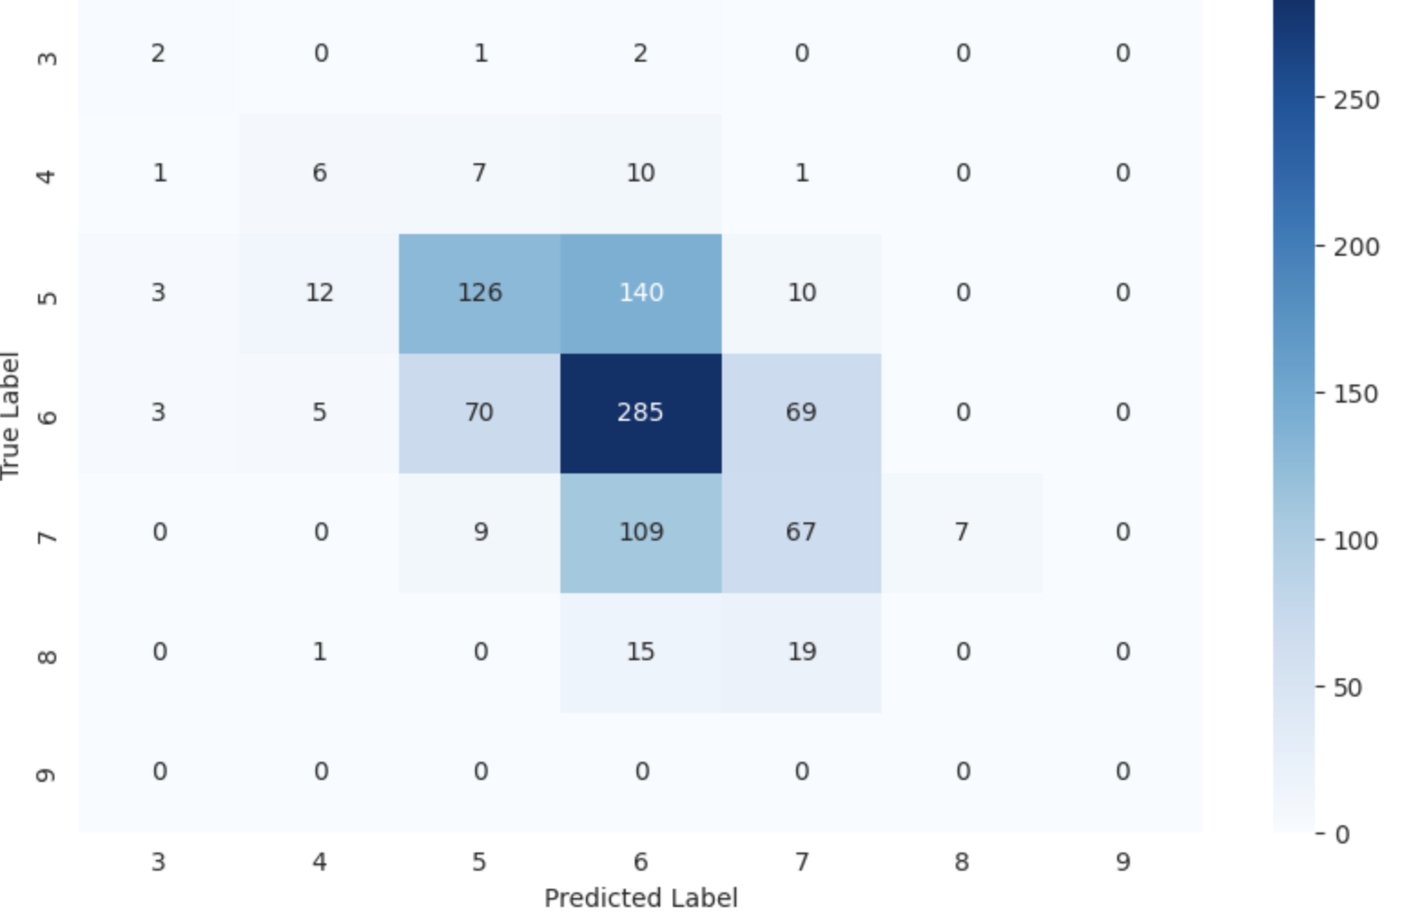
Naive Bayes
We applied PCA to reduce the dimensions of the data.
We retained 95% of the original variance, which means we kept most of the important information.
By using the transformed data with reduced dimensions, we observed an improvement in the model's accuracy, precision, recall, and F1 score.

Slide 29
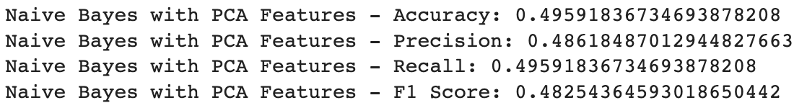
Naive Bayes - Conclusion
The dataset poses challenges, possibly due to its inherent complexity, noise, or imbalance. While we tried various techniques, achieving an accuracy above 50% was challenging. The Naive Bayes classifier, being a relatively simple model, might have limitations in capturing the complexities of this dataset. Advanced models or deeper domain-specific feature engineering might offer better results.

Slide 30
PART three
Random Forest
Using Random Forest to Analyze Wine Quality Data

Slide 31
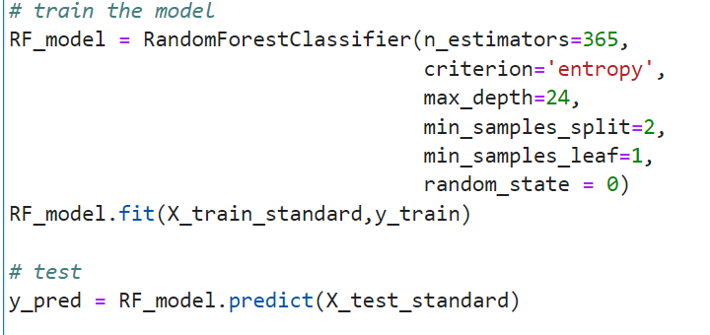
Random Forest
Five Parameters ：
· n_estimators：number of trees
· criterion：entropy or gini
· max_depth
· min_samples_split
· min_samples_leaf

Slide 32
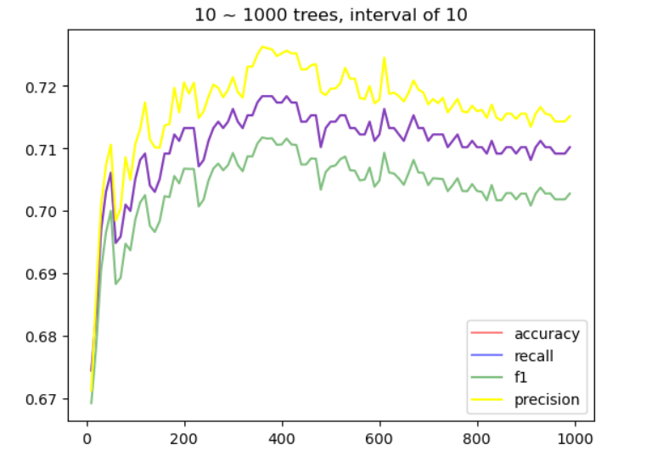
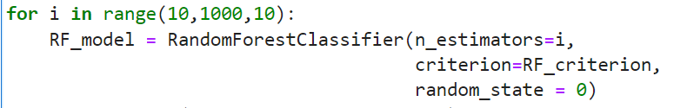
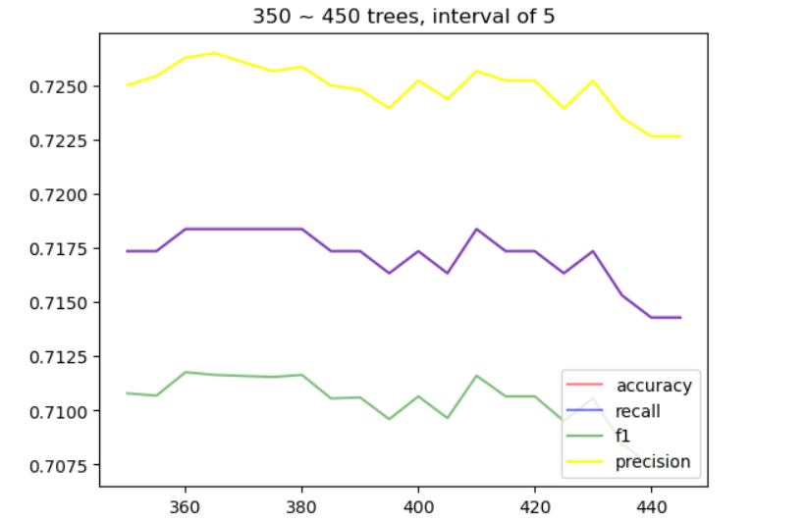
Random Forest
criterion=’entropy’, n_estimators = i,
...
others = default value
↓
n_estimators = 365 is best

Slide 33
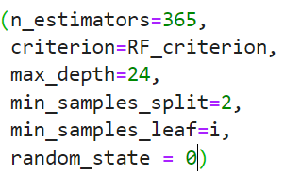
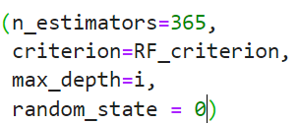
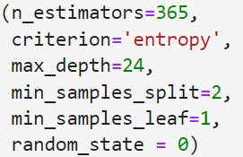
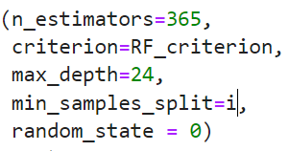
Random Forest

Slide 34
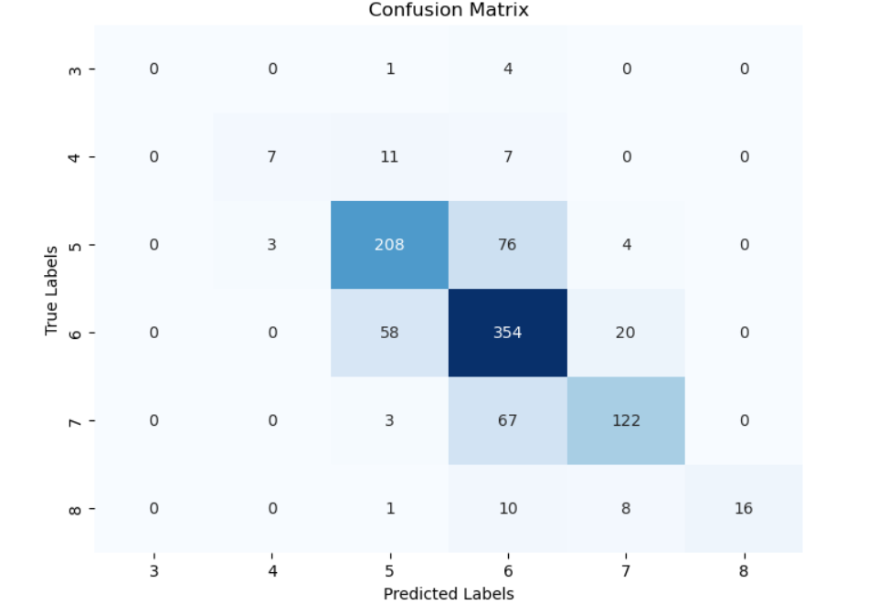
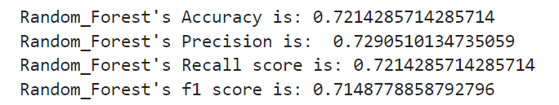
Random Forest

Slide 35
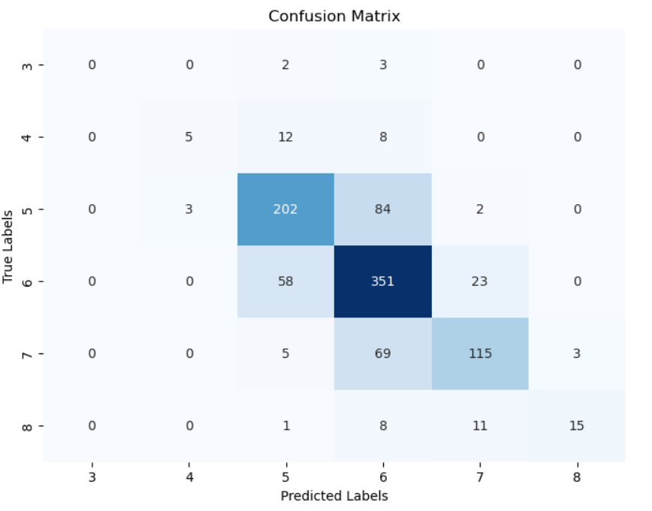
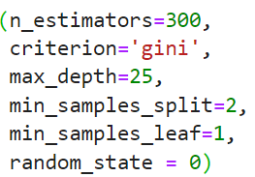
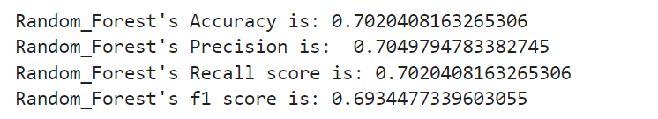
Random Forest

Slide 36
PART three
Neural Network
Using Neural Network to Analyze Wine Quality Data

Slide 37
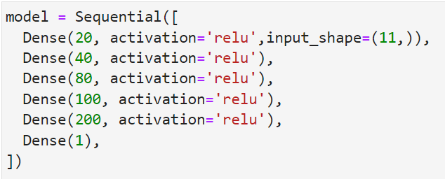
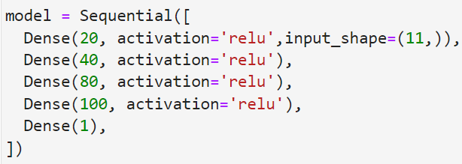
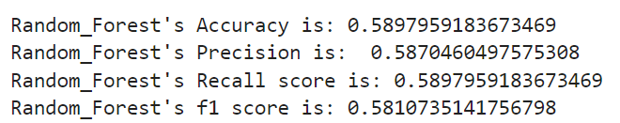
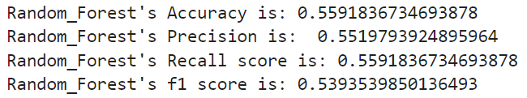
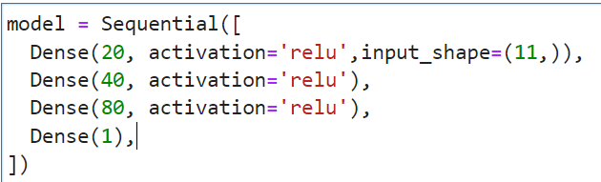
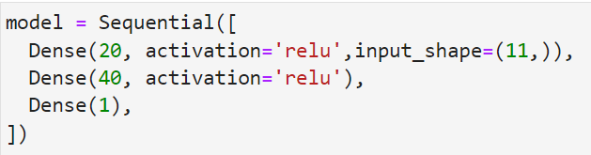
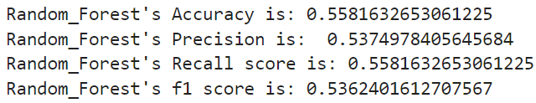
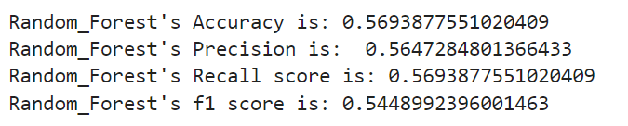
Neural Network

Slide 38
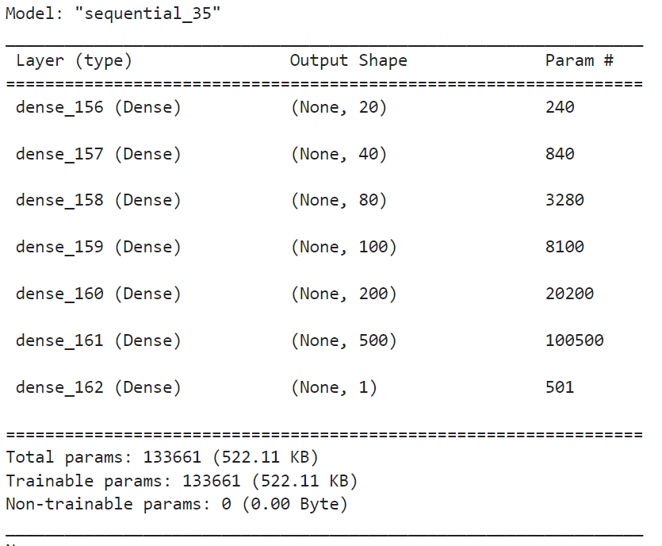
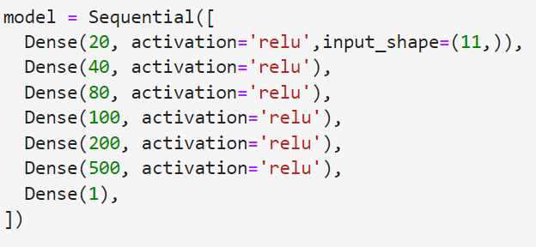
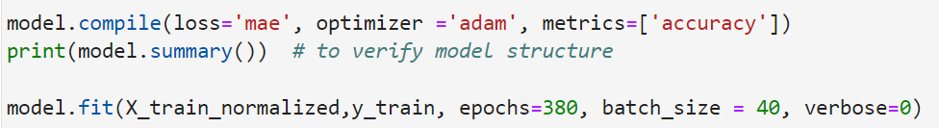
Neural Network

Slide 39
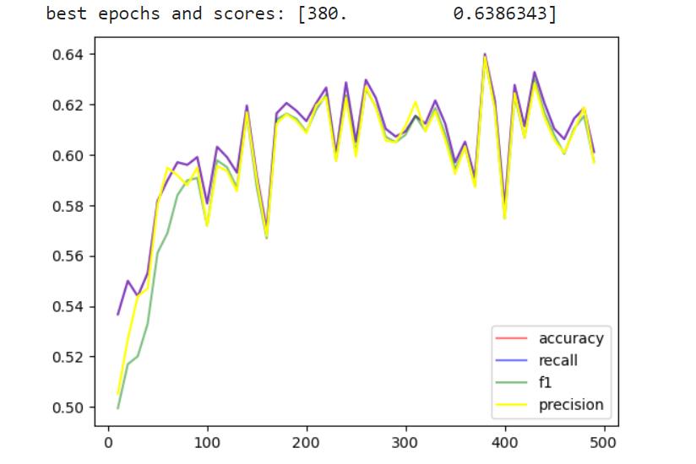
Neural Network

Slide 40
03
PART four
Comparison

Slide 41
Comparsion
The highest accuracy for Naive Bayes was around 49.6%.
SVM had an accuracy of 65%.
Random Forest boasted an accuracy of 70%.
Neural Network's accuracy is about 63.8%.
This highlights the superiority of SVM and Random Forest in capturing patterns in this dataset, with Random Forest being the top performer among the three due to its ensemble approach and ability to handle high-dimensional data.

Slide 42
04
PART four
Conclusion

Slide 43
Conclusion
Guess the reason
The performance hierarchy of the models on our dataset (Random Forest > SVM ≈ Neural Network > Naive Bayes) can be attributed to the inherent complexities and assumptions of each model. Random Forest's ensemble approach, combined with its capability to capture complex feature interactions, likely gives it an edge. SVM, with its flexibility, stands in the middle, while Naive Bayes, with its simplicity and strong assumptions, might not be best suited for this particular dataset's intricacies.
Because we do not have enough time, the performance of Neural Network is not good. There is still much room for improvement.

Slide 44
Thanks for
Listening !
Group 1
Haoxuan Liu, Zikang Liu, Hongyuan Jia

